Slide 1
Curriculum and other strategies to address learning and digital poverty

Slide 2
Topic List
Topic 1: Where is the Philippines? Learning Poverty?
Topic 2: Curriculum Strategies to improve learning poverty
Topic 3: Improving digital access

Slide 3
Learning Poverty in the Philippines
2022
World Bank: 9 out of 10 children (90%) cannot read a simple text

Slide 4
TIMSS 2019 Performance
Philippines scored the lowest out of 58 participating countries in Math & Science.

Slide 5
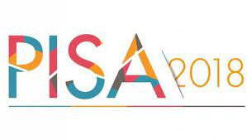
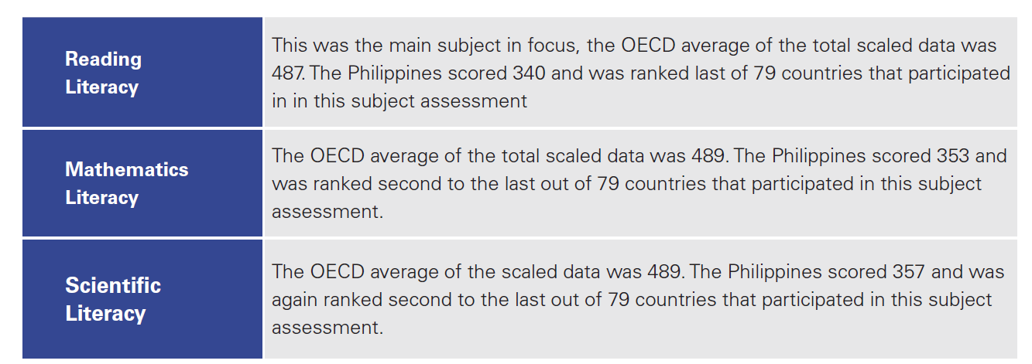
PISA 2018 Performance
Philippines scored the lowest out of 79 participating countries in Reading.

Slide 6
Topic List
Topic 1: Where is the Philippines? Learning Poverty?
Topic 2: Curriculum Strategies to improve learning poverty
Topic 3: Improving digital access

Slide 7
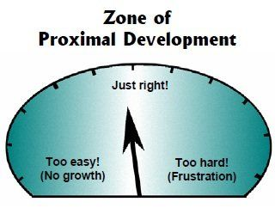
Strategy 1: Learning that matches
The Zone of Proximal Development (ZPD) was a key construct in Lev Vygotsky's theory of learning and development. The Zone of Proximal Development is defined as the space between what a learner can do without assistance and what a learner can do with adult guidance or in collaboration with more capable peers.

Slide 8
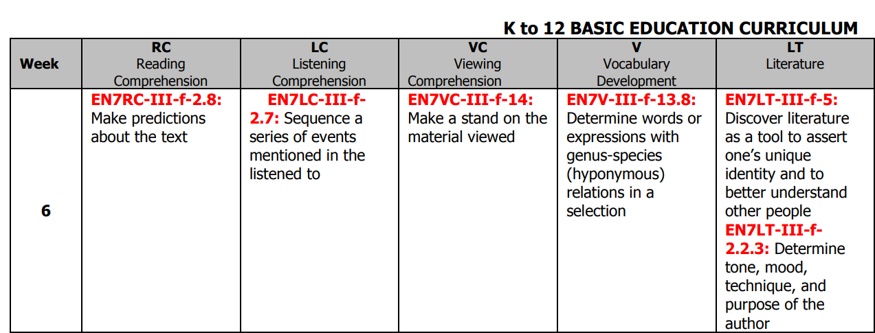
Strategy 1: Learning that matches
This is English curriculum for a Grade 4 student, 90% of which cannot read simple sentences. The difficulty of the curriculum should be appropriate for the ability of the student.

Slide 9
Strategy 2: Leveraging Open Educational Resource
The Philippines has a GDP which is less than 1% of the entire world. The education budget of California ($128 billion) is 10x larger than the education budget of the Philippines ($11 billion)
Instead of looking for FREE resources that match our curriculum. Why don’t we match our curriculum to the FREE and AVAILABLE Open Educational Resources?

Slide 10
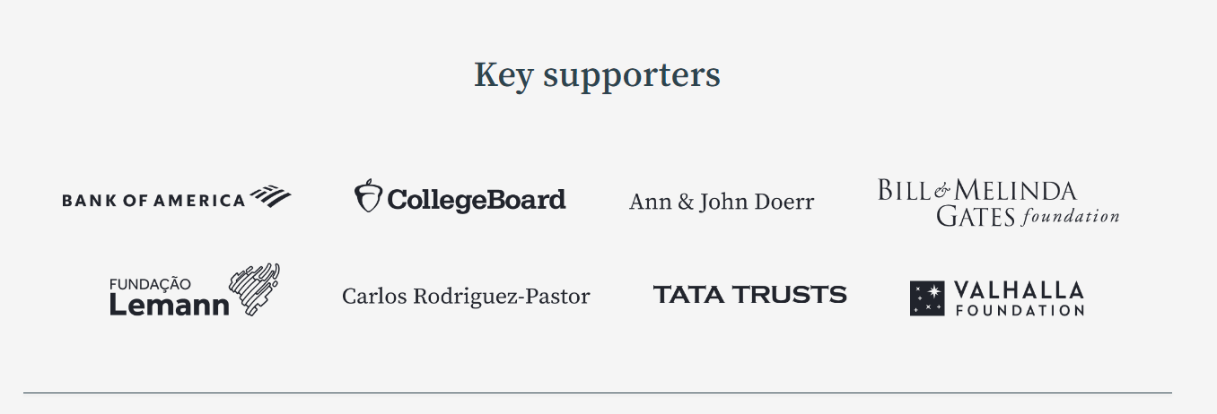
Example: Khan Academy (US Aligned)
Notes:
https://skoll.org/organization/khan-academy/

Slide 11
Strategy 3: Using International Standards

Slide 12
Strategy 3: Using International Standards
Problem: Philippines has no global language targets
Solution: Create global language targets
CEFR Level | Malaysia (PISA Rank 52/79) | Thailand (PISA Rank 61/79) | Vietnam | Philippines (PISA Rank 79/79)
C1 or higher - Proficient | English Teacher | English Teacher | English Teacher | No target
B2 – Upper-Intermediate | Higher Ed (High B2) High School (Low B2) | Higher Ed | Higher Ed | No target
B1 – Intermediate | Grade 6 | Grade 12 | Grade 12 | No target
A2 – Upper-Beginner | Grade 3 |  |  | No target
A1 – Beginner |  |  |  | No target

Slide 13
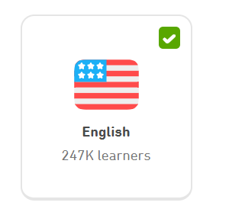
Strategy 3: Using International Standards
Google Play QR Code
Duolingo is the world’s most popular language learning application with 500 million learners.
All 60 million Filipino smartphone users benefit (CEFR A1/A2)
Duolingo teaches 30+ languages with CEFR aligned courses
The English for Tagalog Speakers course is now available for FREE (200K+ learners). English for Vietnamese speakers has 9.8 million learners

Slide 14
Duolingo

Slide 15
Topic List
Topic 1: Where is the Philippines? Learning Poverty?
Topic 2: Curriculum Strategies to improve learning poverty
Topic 3: Improving digital access

Slide 16
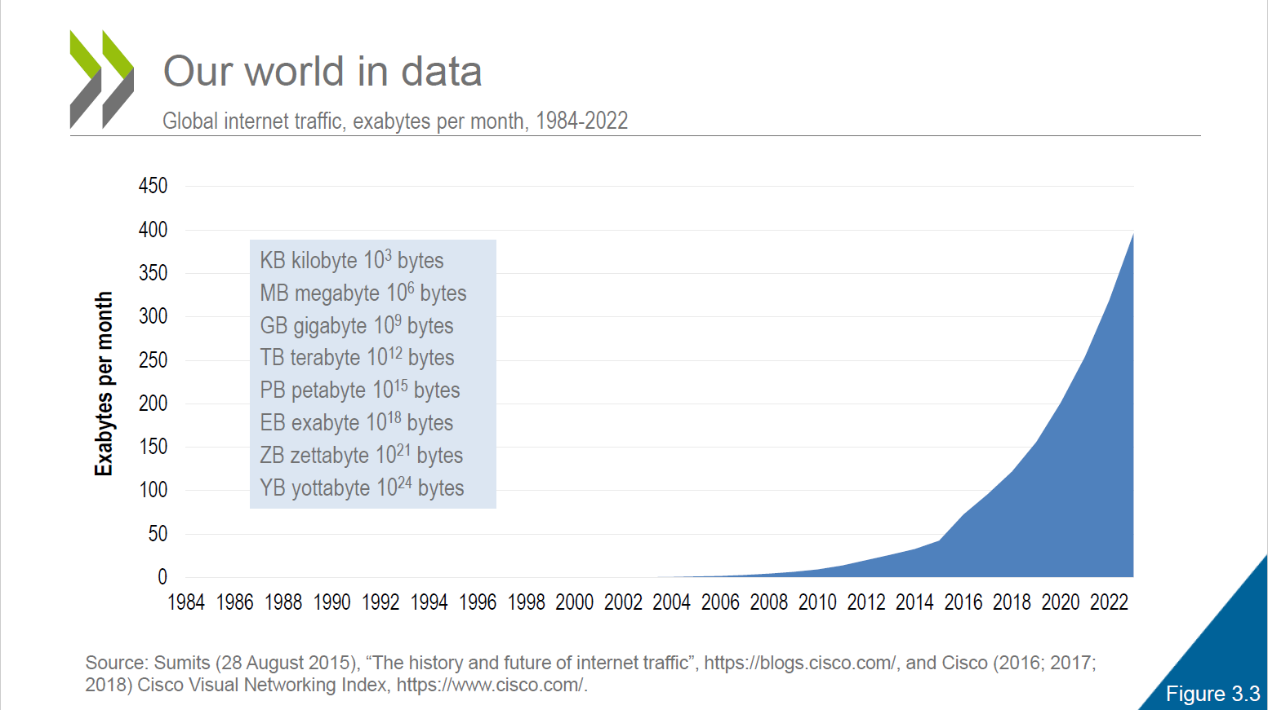
Our World in Data

Slide 17
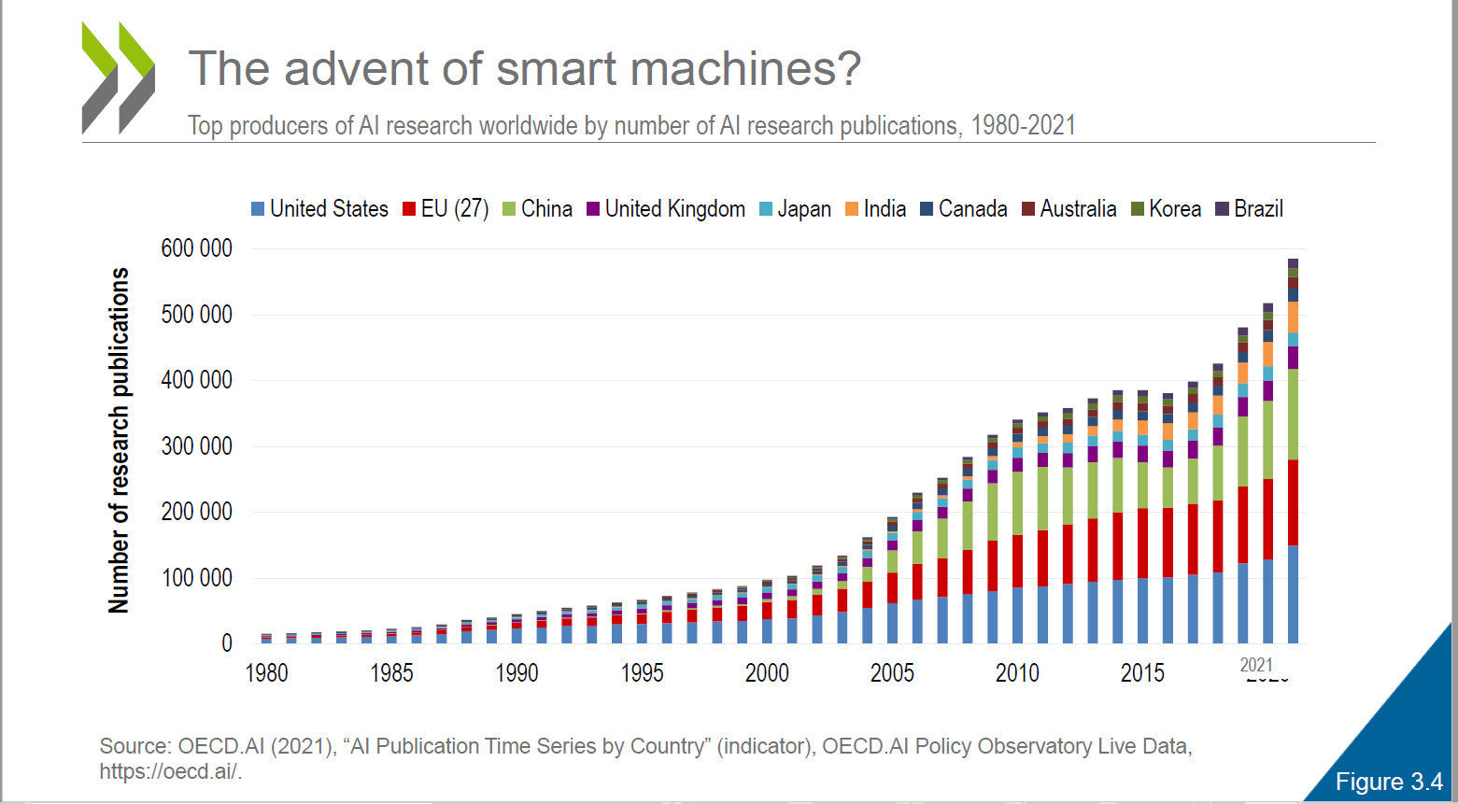
Increasing number of Smart Machines

Slide 18
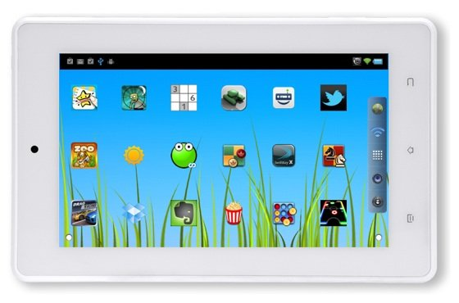
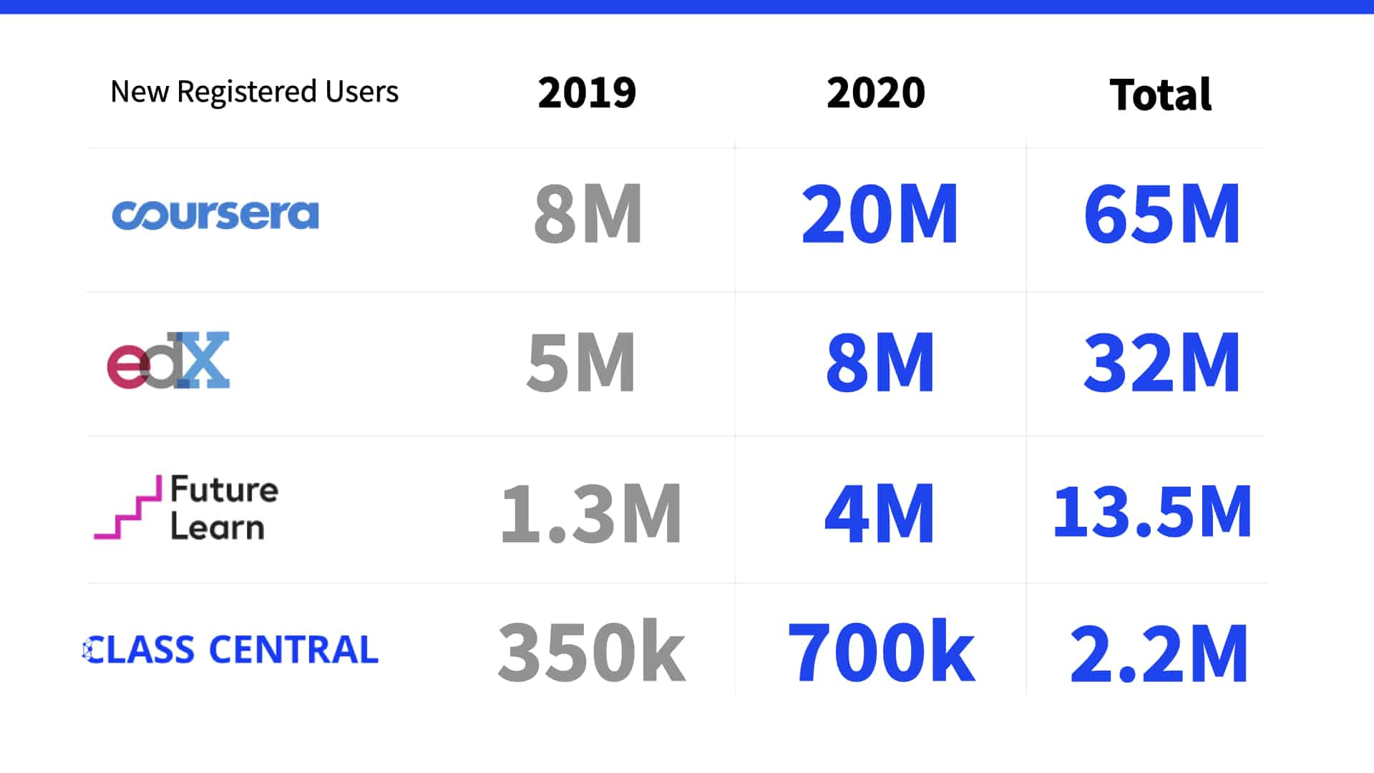
Two big leapfrogs
Low Cost Tablet
($80)
Can hold the world’s body of knowledge
(Except most free apps are in English)
Free World Class Education at no cost
(except 90%+ in English)
Notes:
Lets go back 30 years ago, behind me is actually a set of Encyclopedias.
You know your age if you have actually purchased one, it used to cost how many months pay?
Now that has become free - thanks to Wikipedia. It also fits in a device called the SD card where 4gb - costs around 200 pesos.
So there are two biggies in the world, which allow countries to leapfrog global talent development
1. Low cost tablets - as low as $80 which can easily hold the world's body of information.
2. Free Education on Coursera, Youtube and others.
* CCNA course on Youtube for free, better quality than many paid teachers.
* Cisco lab used to cost PHP 2 million, with training per student costing around PHP 50,000.
* Importance of English (All of the top websites offering free world class, next generation learning are in English) - Coursera, Youtube, EDX and others. If you do not speak English - you are locked out of the major benefits of the global knowledge economy.
* Duolingo experience - There are teams now in USA Multinationals which specialize in hiring contractors from around the world to work from home.

Slide 19
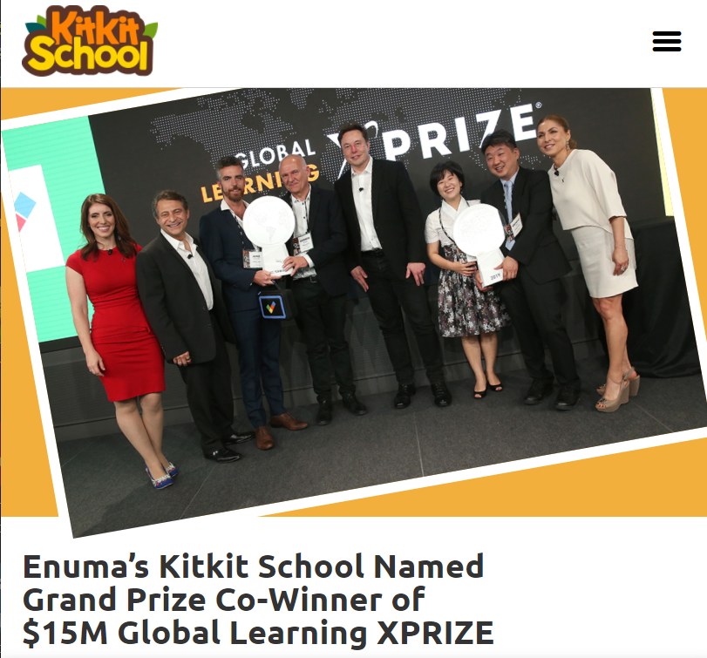
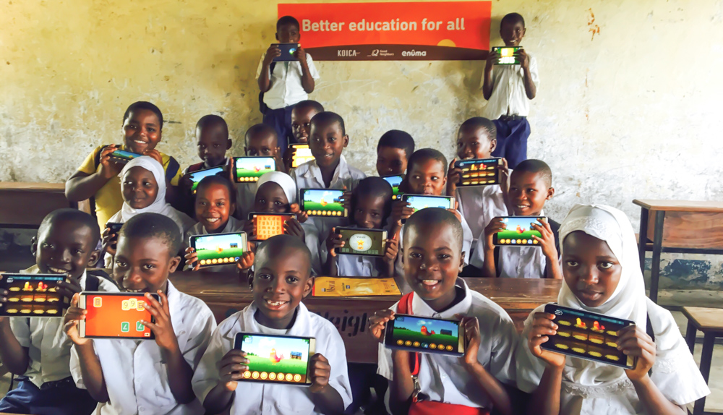
X-Prize: Low Cost Tablet
Mission is to bring high-quality learning experiences to the children who need them the most around the globe. Named for the word “to think” in Thai, Kitkit School is a tablet-based learning suite with a comprehensive curriculum that spans early childhood through early elementary. It is designed to provide children with the foundations and practice needed to build fundamental skills in literacy and numeracy regardless of access to school or resources.

Slide 20
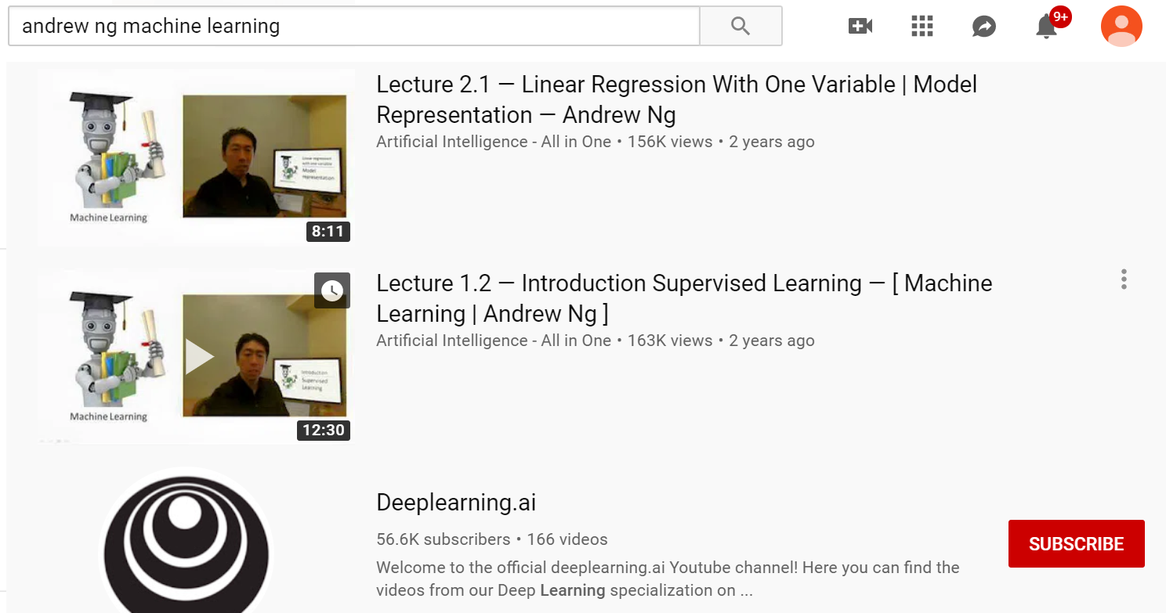
World Class Education – for free?
Andrew Ng (Course on AI – free on Coursera)
Founder of Coursera ($5B market capitalization)
Founder of Google Brain
Head of Baidu (the Google of China) Artificial intelligence team with 1,000 FTE
Professor of Stanford in Artificial Intelligence
CCNA (Cisco 200-301)
World’s most popular networking exam (Tuition still costs PHP 150k in the Philippines, FREE on Youtube)
Lab equipment costs (1M+) – now free with Cisco Packet Tracer
What language do you think these resources are in: FREE CCNA Course (Youtube), AI Course (Coursera), Cisco Packet Tracer Virtual Lab Software?

Slide 21
Summary
Learning poverty in the Philippines is an extremely serious problem with 90% of 10 year old students unable to read a simple text (World Bank)
Several strategies to improve curriculum: (a) Match difficulty levels, (b) Leverage the world producing OER and (c) Use international standards
Improving digital access to low cost devices is the next leapfrog moment in education

