Slide 2
What Work Arrangements are Best for Productivity: Work from Home, Hybrid, or Onsite/In Office?
Melva M. Diamante, D.B.A.
Daniel W. Steel
November 11, 2022

Slide 3
Outline
Introduction
Research Objectives & Research Questions
Research Findings
Conclusion and Presentation of Model
Reflections

Slide 4
Mixed results in research on Productivity and Work Arrangements
“Covid -19 QUICKLY SHIFTED WORK DYNAMICS. Not only did it debunk most of the myths about working remotely, it actually increased productivity to unexpected levels”. (Brinkinshaw, HBR, 2021).
Monteiro et.al.’s study of Portuguese firms of all sizes found that the average productivity effect of allowing remote work is significantly negative (2019)

Slide 5
Although studies today show that WFH has the potential to improve productivity and economic as well social indicators, results of research on its impact are still mixed.

Slide 6
The Impact of Work-from-Home (WFH) and Face-to-Face Work on Employee Productivity: A Model for Post-Pandemic Productivity
RESEARCH OBJECTIVES
1. Present a comprehensive survey of the influence of work arrangements on employee productivity.
2. Identify contemporary key performance indicators (KPIs) that organizations use to measure workplace employee productivity

Slide 7
Research Objectives, continued
3. Determine if employees are more productive while they Work-from-Home
or ONSITE in their office.

Slide 8
4. Compare the tasks employees perform more productively while Working from Home and tasks they perform more productively when they work IN OFFICE/ONSITE.

Slide 9
Research Objectives, continued
5. Develop a framework that could be useful in identifying the work arrangement structure to enhance employee productivity.

Slide 10
Research Questions
1. Are employees more productive when working from home or working in an ONSITE /IN OFFICE setting?
2. What is the impact of Work Arrangement on Employee Productivity?

Slide 11
Research Questions
3. What is the impact of Behavioral Factors, Organizational Factors, and Job Content on Productivity?
4. Do employees’ Demographic profiles affect the relationship between Work Arrangement and Productivity?

Slide 12
Conceptual Framework
Demographic Profile
Work Arrangement
WORK-FROM-HOME
IN OFFICE/ONSITE
PRODUCTIVITY
Behavioral Factors
Engagement
Motivation
Satisfaction
Organizational Factors
Job Content

Slide 13
Definition of Terms
WFH/ TELECOMMUTING
Employee works outside of the employer's office, in an alternative workplace; Work is conducted with the use of electronic devices, the internet, etc. (R A 11165, the Telecommuting Act, 2018).
IN-OFFICE/ ONSITE
Work is conducted in the organization’s office building or location and employees conduct their work primarily face-to-face.
HYBRID
Work is conducted through both In-Office and Work From Home

Slide 14
Definition of Terms
PRODUCTIVITY
Efficiency: level and quality of services obtained from a given amount
of resources; Output : Input ratio
Services completed per time period
Value of Output : Cost of Input
Effectiveness : extent to which provider meets the needs/demands
of stakeholders or customers (Goals, KPIs)
Performance evaluation self-assessment & assessment by
supervisor
Customer service surveys; Organization Climate Surveys
Student Achievement

Slide 15
Definition of Terms
Demographic/Work Profile: Age, Sex, Dependents, Length of
Employment, Current Work Arrangement, Job Role
Behavioral Factors: Employee Engagement, Motivation, Satisfaction
Organizational Factors: Workplace environment, distractions, sufficient material resources, nature of supervision
Job Content: Role clarity, opportunity for skill development, support/feedback, meaningfulness of job, autonomy

Slide 16
Methodology
Sample Size: 1000+
Data collection:
Questionnaires
Organizational metrics – Productivity measures
Quantitative Analysis: Descriptive and Inferential
Statistics
Qualitative Analysis: Thematic Analysis of
responses to open ended questions

Slide 17
FINDINGS

Slide 18
Table 1 - Current Work Arrangement
Academe
Employees Management
WFH 7.3% 3%
ONSITE 92.7% 97%
Government
Employees Management
WFH -- --
ONSITE 53% 31%
HYBRID 47% 69%

Slide 19
Table 2 - Work Arrangement Preference
Academe
Subordinates according to
Employees Management
WFH 14.7% 7%
ONSITE 58% 61%
Hybrid 27% 32%
Government
Subordinates according to
Employees Management
WFH 11% ---
ONSITE 23.5% 23%
HYBRID 66% 77%

Slide 20
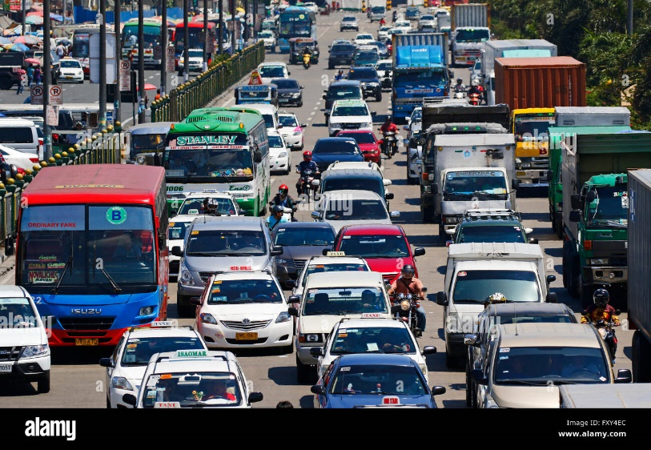
Why Preference for Work From Home?
Top Five Responses**
1. Avoid commute
2. Health
3. Can spend time
with family
4. Fewer distractions
5. Better food
** Ranked responses

Slide 21
Why Preference for Work IN OFFICE/ ONSITE?
Top Five Responses **
1. Sets the work parameters
(9:00 am-5:00 pm)
2. Working with people
3. Socializing with coworkers/
clients
4. Lessen screen time during meetings
5. More creative in a collegial
atmosphere/ More fun in person without
the screen
** Ranked responses

Slide 22
Table 3 - In what work arrangement are employees more productive?
Academe
Self-report Manager’s Report
WFH 44.9% 39%
ONSITE 79.6% 87%
Government
WFH 53.8 % 56%
ONSITE 75.5% 80%

Slide 23
Organizational Metrics
Efficiency Measures: output – input ratio
Mixed results
Effectiveness measures: based on organization objectives-
Increase of productivity among all the
organizations surveyed (100%)
during the pandemic period (2020– 2021)
compared to pre-pandemic period.

Slide 24
Factors negatively Affecting Productivity at Work?
Top Five
Workplace distractions
Poor management
No longer motivated by my work
Lack of defined goals in my work
Organizational Changes

Slide 25
Contribution of Behavior, Organization Factors, & Job Content on Employee Productivity – Work From Home
Work profile: R² = .23
- Work Arrangement
- Job Role
- Work Arrangement Preference
- Hours of Work per Week
Organizational Factors - Work Environment R² = .32
- Effectively stay connected with my team
- Confident working without my supervisor
- Work space is safely accessible and conveniently
located
- Communication with and support for subordinates

Slide 26
Contribution of Behavior, Organization Factors, Job Content, Demographic Profile on Employee Productivity
Work From Home, continued
Job content R² = .32
- Work is meaningful
- Role clarity
- Sufficient opportunity for skill development
- Autonomy to complete my work
Demographic Profile R² = .004
- Gender

Slide 27
Contribution of Behavior, Organization Factors, & Job Content on Employee Productivity IN OFFICE
Work Profile R² = .13
- Work Arrangement
- Work Arrangement Preference
Behavior Factors R² = .29
- Motivation
Job Content R² = .29
- Work is meaningful
- Role clarity
- Sufficient opportunity for skill
development
- Autonomy to complete my work

Slide 28
Summary of Findings
At the time of the survey 69% of the government workforce have started with HYBRID work arrangement while in the academe 97% of the employees have returned to their offices.
In terms of preference, only HYBRID and IN OFFICE work arrangements were mostly selected by government and academe employees and managers as preferred work arrangements.

Slide 29
Summary of Findings
3. Both academe and government respondents believe that employees are more productive in IN OFFICE arrangement.
It is noteworthy to consider, however, that more than majority of government employees and managers Indicated that WFH arrangement can also increase employee productivity.

Slide 30
From the organizational metrics collected, it is clear that effectiveness measures of productivity (e.g., performance evaluations and customer surveys) indicate an increase in productivity in WFH from Year “1” (prior to COVID-19) to Year “2” in the midst of COVID-19, among 100% of participating organizations.

Slide 31
Summary of Findings
5. Results of efficiency measures (financial output: input ratios) showed mixed results. There were several organizations that experienced increase in productivity from Year “1” to Year “2” while a few had a decrease in productivity or no change in productivity.

Slide 32
Summary of Findings
The series of regression analyses indicate
that employee work profile, work
environment and job content are factors that
significantly influence employee productivity
for those who are working from home.

Slide 33
Summary of Findings
7. Demographic profile did not have any significant impact on productivity whether the work was performed WFH or IN OFFICE.
8. For employees working ONSITE, motivation and job content were the only two factors found to influence their productivity with a fairly moderate ability to explain variations in productivity.

Slide 34
Conclusions
“COVID-19 quickly shifted work dynamics. Not only did it debunk most of the myths about working remotely, it actually increased productivity to unexpected levels.”
– Brinkinshaw, HBR, 2021

Slide 35
Conclusions
Academe - Strong Majorities prefer In-Office Work
Gov’t – Strong Majorities prefer Hybrid Work
Few respondents prefer WFH
In both Academe & Gov’t, strong majorities felt they were most productive In-Office while bare majorities felt WFH was most productive
Productivity (Effectiveness) increased during WFH in the pandemic.

Slide 36
Conclusions
Organizational factors, Work Profile, Behavioral factors (Motivation), & Job Content all had moderate or strongly significant relationships with Productivity in both WFH and In-Office work.
Academe – With a substantial minority of respondents preferring Hybrid work arrangements and a majority indicating better productivity in WFH, a concerted effort to examine which, if any, hybrid work arrangement for selected employees would be prudent.
Government – With large majorities preferring Hybrid work and a majority indicating better productivity in WFH, a concerted effort to examine which, if any, hybrid work arrangement for selected employees would be prudent.

Slide 37
Work Arrangement Model
Organization Level
Dept / Function Level
Team Level
Individual Level
ORG LEVEL:
Can the Org function 100% Remote? Y/N
If yes, is productivity compromised? Y/N
To what degree? (>10%)_____
For which depts/functions? ______
If no, what depts/functions cannot work 100% remote?
To what extent is this possible to overcome? (>50%) _______
What capital/material/time investment would it take to overcome? (Php 5M – 6 mo) ________

Slide 38
Work Arrangement Model
Organization Level
Dept / Function Level
Team Level
Individual Level
DEPT LEVEL:
Can this dept operate 100% remote? Y/N
If yes, what facets of work are more productive in-office? (meetings)_____________
Can those be made as or more productive remotely as they are in-office? Y/N
If no, what facets can be done remotely? (asynch /email) ______
Can those be made as or more productive remotely as they are in-office? Y/N
What percentage of the dept personnel would be negatively affected by 100% remote work? (~20%)______

Slide 39
Work Arrangement Model
Organization Level
Dept / Function Level
Team Level
Individual Level
TEAM LEVEL:
Can this team operate 100% remote? Y/N
If yes, what facets of work are more productive in-office? (meetings)_____________
Can those be made as or more productive remotely as they are in-office? Y/N
If no, what facets can be done remotely? (asynch /email) ______
Can those be made as or more productive remotely as they are in-office? Y/N

Slide 40
Work Arrangement Model
Organization Level
Dept / Function Level
Team Level
Individual Level
INDIVIDUAL LEVEL:
Can you work 100% remote? Y/N
If yes, what facets of work are more productive for you in-office? (meetings)_____________
Can those be made as or more productive remotely as they are in-office? Y/N
If no, what facets can be done remotely? (asynch /email) ______
Can those be made as or more productive remotely as they are in-office? Y/N

Slide 41
How can you apply this model?
Flip your assumptions/conventional wisdom. Start from the position that remote work is the more productive work arrangement.
Answer the questions starting at the Org Level and working down to the Individual.
Upon completion, critically examine the roadblocks preventing remote work.
Based on the outputs of this model, select between the Five Hybrid Work Models of Razzetti for best org fit.

Slide 42
FIVE HYBRID WORK MODELS - Razzetti
OFFICE-CENTRIC
Fixed Hybrid
Collaborative Days
Remote Friendly
Flexible Hybrid
Remote First
FLEX PER
TEAM
SINGLE
APPROACH
DIGITAL-CENTRIC

Slide 43
The Changing Face of Work
“Working from home is here to stay, with hybrid arrangements fast becoming the dominant strain… By 2022, the typical firm will have everyone in the office three days a week, typically Tuesday to Thursday, and working from home Monday and Friday.”
10% of US workforce to be 100% Remote
40% to be Hybrid (3 Day/week in office)
50% to remain Onsite
Dr. Nicholas Bloom
Professor of Economics
Stanford University

Slide 44
Reflections
It is clear from the study that some form of Hybrid work arrangement or some combination of WFH and IN Office arrangement is not only preferred but is potentially the work structure that could possibly create higher levels of employee productivity.

Slide 45
Reflections
If we were to decide to change the Work arrangement in our organization, based on the series of questions presented earlier in the Work Arrangement Model:
We have to determine that we are ready for change. Some questions to reflect on are:
Will change compromise productivity?

Slide 46
Reflections
What Factors contribute to Productivity in WFH and IN Office settings in our specific organization?
What could affect productivity negatively?
What functions are performed more effectively
and efficiently in ONSITE/IN OFFICE or WFH?

Slide 47
Reflections
Do we have the mechanism and resources to
support the required change?
Is our organization capable of change – change in
mindset; culture change?
Different work arrangement structures create different employee and management expectations.

Slide 48
Reflections
Different structures require different mindsets, different behaviors, and different leadership styles
Making a choice almost requires
a great deal of
assessment, experimentation and time to implement.

Slide 49
Q & A

Slide 50
Thank you!

